Slide 1

School of Computing Science and Engineering
School of Computing Science and Engineering
Program Name: BTech , 5 SEM
Course Code : E2UC502T
Course Name : Software Testing & Quality Assurance
Sofware Testing Techniques and Strategies
Dr. Azath Hussain PhD.

Slide 2
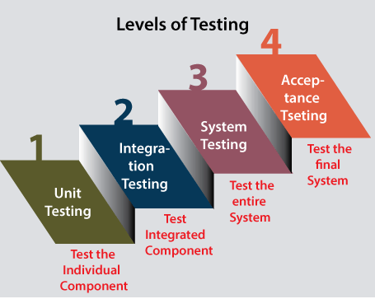
School of Computing Science and Engineering
“Testing Techniques and Strategies"
Levels of Testing
Software testing can be performed at different levels of the software development process. Performing testing activities at multiple levels help in the early identification of bugs and better quality of software product. In this tutorial, we will be studying the different levels of testing namely –
Unit Testing,
Integration Testing,
System Testing, and
Acceptance Testing.

Slide 3
School of Computing Science and Engineering
“Testing Techniques and Strategies"
Unit Testing
Unit Testing is the first level of testing usually performed by the developers. In unit testing, a module or component is tested in isolation.
The reason of performing the unit testing is to test the correctness of inaccessible code.
Unit testing will help the test engineer and developers in order to understand the base of code that makes them able to change defect causing code quickly. Unit testing helps to finds the performance and reliability of the module.
As the testing is limited to a particular module or component, exhaustive testing is possible.
Advantage – Error can be detected at an early stage saving time and money to fix it.
Limitation – Integration issues are not detected in this stage, modules may work perfectly on isolation but can have issues in interfacing between the modules.

Slide 4
School of Computing Science and Engineering
“Testing Techniques and Strategies"
Integration Testing
Integration testing is the second level of testing in which we test a group of related modules.
It aims at finding interfacing issues between the modules i.e. if the individual units can be integrated into a sub-system correctly.
It is mainly used to test the data flow from one module or component to other modules.
In integration testing, the test engineer tests the units or separate components or modules of the software in a group.
It is of four types
Big-bang
Top-down
Bottom-up
Hybrid

Slide 5
School of Computing Science and Engineering
“Testing Techniques and Strategies"
Integration Testing
In big bang integration, all the modules are first required to be completed and then integrated. After integration, testing is carried out on the integrated unit as a whole.
In top-down integration testing, the testing flow starts from top-level modules that are higher in the hierarchy towards the lower-level modules. As there is a possibility that the lower-level modules might not have been developed while beginning with top-level modules.
So, in those cases, stubs are used which are nothing but dummy modules or functions that simulate the functioning of a module by accepting the parameters received by the module and giving an acceptable result.

Slide 6
School of Computing Science and Engineering
“Testing Techniques and Strategies"
Integration Testing
Bottom-up integration testing is also based on an incremental approach but it starts from lower-level modules, moving upwards to the higher-level modules. Again the higher-level modules might not have been developed by the time lower modules are tested. So, in those cases, drivers are used. These drivers simulate the functionality of higher-level modules in order to test lower-level modules.
Hybrid integration testing is also called the Sandwich integration approach. This approach is a combination of both top-down and bottom-up integration testing. Here, the integration starts from the middle layer, and testing is carried out in both directions, making use of both stubs and drivers, whenever necessary.

Slide 7
School of Computing Science and Engineering
“Testing Techniques and Strategies"
System Testing
The third level of software testing is system testing, which is used to test the software's functional and non-functional requirements.
Functional testing checks the application's processes against a set of requirements or specifications.
Non-functional testing assesses application properties that aren't critical to functionality but contribute to the end-user experience, like performance and reliability under load.
It is end-to-end testing where the testing environment is parallel to the production environment. In the third level of software testing, we will test the application as a whole system.
It aims at determining if the application conforms to its business requirements.
System testing is carried out in an environment that is very similar to the production environment.
To check the end-to-end flow of an application or the software as a user is known as System testing.

Slide 8
School of Computing Science and Engineering
“Testing Techniques and Strategies"
Acceptance Testing
Acceptance testing is the final and one of the most important levels of testing on successful completion of which the application is released to production.
The software has passed through three testing levels (Unit Testing, Integration Testing, System Testing). Some minor errors can still be identified when the end-user uses the system in the actual scenario.
It aims at ensuring that the product meets the specified business requirements within the defined standard of quality. The acceptance testing is also known as User acceptance testing (UAT) and is done by the customer before accepting the final product.

Slide 9
School of Computing Science and Engineering
“Testing Techniques and Strategies"
Acceptance Testing
Usually, UAT is done by the domain expert (customer) for their satisfaction and checks whether the application is working according to given business scenarios and real-time scenarios.
There are two kinds of acceptance testing- alpha testing and beta testing.
When acceptance testing is carried out by testers or some other internal employees of the organization at the developer’s site it is known as alpha testing.
User acceptance testing done by end-users at the end-user’s site is called beta testing.

